Slide 1
FloodSense
Predictive flood alerts for Singapore
By Team Master Corgis
[Team Names]

Slide 2
Agenda
Social Impact
Who benefits, how much, and whether the solution could realistically be adopted.
01.
Demo
A usable dashboard, app or interface a non-technical stakeholder could act on.
02.
Why Databricks
A working end-to-end pipeline: ingestion, transformation, governance, analytics or AI.
03.
Data Rigour
Sound use of Singapore open data, handling of messy data, and honest limitations.
04.
Q&A
05.

Slide 3
Social Impact
01.
Social Impact
01.
Demo
02.
Why Databricks
03.
Who benefits, how much, and whether the solution could realistically be adopted.
Data Rigour
04.
Q&A
05.

Slide 4
PUB Flood Alerts
We can infer that “Risk of Flash Floods” alerts are issued when sensors detect drain water levels reach a critical threshold.
Inferred from PUB’s official flood alert channel.

Slide 5
Problem
With rising rainfall, drains fill up faster. In 2026, the average time from when the water levels went from critical to a flash flood was 16.6 minutes, which is very little time to react.
92.5 mm
~15
16.6 min
Rise in rainfall every 10 years
Flash floods per year
Average alert lead time before a flood
1 Jan 2026 to 29 Oct 2026

Slide 6
Solution: FloodSense
FloodSense forecasts, every 5 minutes, which of NEA’s 47 weather‑forecast areas is likely to get a
flash flood in the next hour, rating each Low, Moderate or Elevated.

Slide 7
Solution: FloodSense
FloodSense forecasts, every 5 minutes, which of NEA’s 47 weather‑forecast areas is likely to get a
‘risk of flash flood’ alert in the next hour, rating each Low, Moderate or Elevated.

Slide 8
Who benefits?
Earlier, predictive flood alerts give each group time to act before the water arrives
Commuters
Residents & shops
Agencies
Avoid flood-prone roads while on the move
Set up flood barriers before water rises
Deploy personnel in advance
Median car commute: 30 min
Incl. shop owners & town councils

Slide 9
Demo
02.
Social Impact
01.
Demo
02.
Why Databricks
03.
Data Rigour
04.
A usable dashboard, app or interface a non-technical stakeholder could act on.
Q&A
05.

Slide 10
Metrics
0.930*
ROC-AUC
ROC curve area
Rainfall-only: 0.85¹
0.018
PR-AUC
PR curve area
vs 0.020% alert rate
~90× chance level
4–6 of 8
Floods caught
Moderate or elevated²
35.7 min
Mean lead time
Predicted floods only³
7.8%
Alert within 1 h
of moderate/elevated warning
0.77%
Flash flood within 1 h
of moderate/elevated warning
9.3%
Alert within 1 h
of elevated warning
0.32%
Flash flood within 1 h
of elevated warning
1. ROC-AUC is inflated because flash floods are rare
2. Range because a Woodlands flash flood was predicted only as it happened, and a Marine Parade flash flood occurred 1 h 2 min after the initial warning
3. 37.3 min if Woodlands and Marine Parade are excluded
Notes:
So how does floodsense perform?
Its ROC-AUC is 0.93, which is better than the rainfall baseline at 0.85. Do note that these numbers are inflated due to the class imbalance resulting from flash floods being rare.
The PR-AUC is 0.018, which is 90 times better than random chance.
Of the 8 floods, 4 to 6 floods were caught. One flood occurred right as it was predicted, while another flood happened 1 hour 2 minutes after it was predicted, so the number varies depending on how lenient we count.
The average lead time was an improvement to 35.7 minutes, which beat our initial goal of 30 minutes.
However, floodsense is not yet ready, as it has rather high false positive rates.

Slide 11
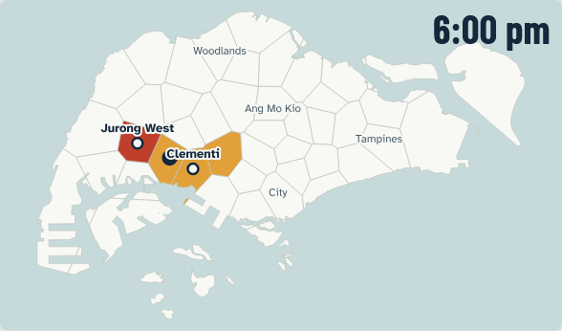
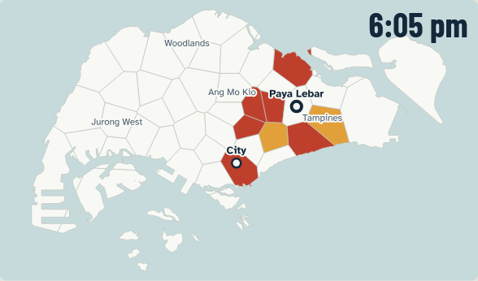
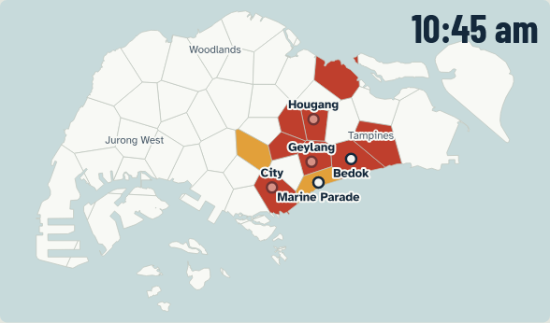
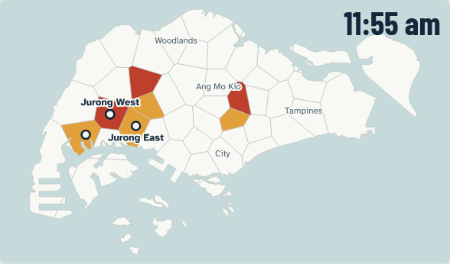
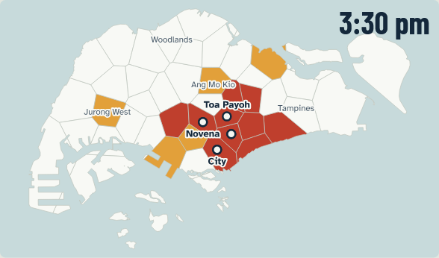
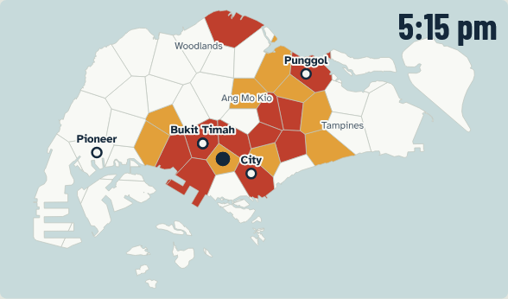
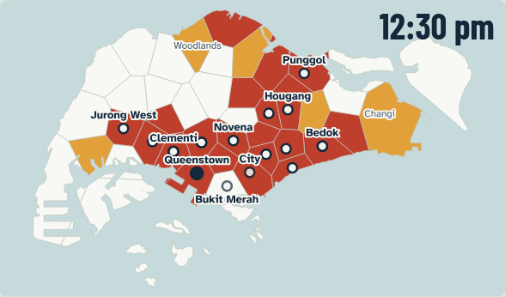
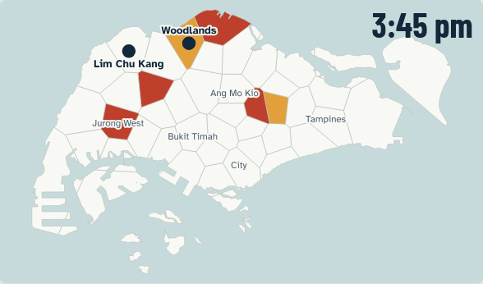
Metrics
In 2026, general region predicted is reasonable
18 Feb 2026
5 May 2026
15 May 2026
22 July 2026
11 Sept 2026
22 Sept 2026
27 Sept 2026
30 Sept 2026
Notes:
But I believe it has been shown that the direction of the solution is feasible. FloodSense predicted the alerts in the general vicinity correctly. If we have access to more granular and high quality data, we should be able to narrow the predictions to more precisely predict the alerts and hence flash floods.

Slide 12
Why Databricks
03.
Social Impact
01.
Demo
02.
Why Databricks
03.
Data Rigour
04.
Why Databricks is the platform of choice.
Q&A
05.

Slide 13
Why Databricks
At its core, it simplifies data engineering.
Data and AI in one place
Fast from idea to live
Pipelines, models, dashboards and the app all work from one copy of the data
Managed, serverless compute lets a small team ship a live system without running servers
Scales with the mission
Open and trusted
The same design can grow to more cities, more sensors or new hazards without a rebuild
Open data formats avoid lock-in, and built-in governance gives agencies an audit trail

Slide 14
The Data Pipeline
Lakeflow
  Jobs
  Spark Declarative Pipeline
Auto-Loader
Unity Catalog
Lakehouse
Delta Tables
Bundles
Jev

Slide 15
Designing a Model in Databricks
MLflow
SQL Warehouse

Slide 16
Building an App
Databricks Apps
AI/BI Dashboard
Genie Agent

Slide 17
Data Rigour
04.
Social Impact
01.
Demo
02.
Why Databricks
03.
Sound use of Singapore open data, handling of messy data, and honest limitations.
Data Rigour
04.
Q&A
05.

Slide 18
Data sources: what the model reads
NEA rainfall
API (2025 on), CSVs (to 2024)
16 of 25 columns: nearby/upwind rain, gauge count, storm age, rain surplus, drain flow
NEA 2-hour forecast
API + historical CSVs
Rain class (#1 input, both models), age; defines 47 areas
NEA wind
API + historical CSVs
Wind components; which gauges count as upwind
Source | Where from | What the model reads
NEA rainfall | API (2025 on), CSVs (to 2024) | 16 of 25 columns: nearby/upwind rain, gauge count, storm age, rain surplus, drain flow
NEA 2-hour forecast | API + historical CSVs | Rain class (#1 input, both models), age; defines 47 areas
NEA wind | API + historical CSVs | Wind components; which gauges count as upwind
NEA temperature, humidity | API + historical CSVs | Island-wide averages
Tide | UHSLC Tanjong Pagar, 2005–2023 | Tide height, minutes to high tide (#3 by gain)
Time of day | Derived | SGT hour
NEA temperature, humidity
API + historical CSVs
Island-wide averages
Tide
UHSLC Tanjong Pagar, 2005–2023
Tide height, minutes to high tide (#3 by gain)
Time of day
Derived
SGT hour
Notes:
The data sources used to train the model was NEA rainfall, 2-hour categorical weather forecast, wind speed and direction, tem

Slide 19
Labels
PUB Flood Alerts Telegram channel
pubfloodalerts (formerly sgflood), from 27 Oct 2021
Wayback Machine
Recovers deleted posts
Alert placement
Gazetteer built from OneMap
Hand labels & area prior
Hand labels: Edge cases
Area prior: Built from the same alert history

Slide 20
Handling of Messy Data
Wiped channel
PUB wiped Telegram 4+ times
832 of 1,092 lost posts recovered (Internet Archive)
Hours we still can't see
Counted as missing, never as quiet
Changing formats
10 post formats since 2021
Unreadable posts go to Jev (Databricks)
Jev reads the post
Kept, marked as Jev's
Jev fails too
Hour counted as missing
Either case
Developers get an email
Two fixes
50 alerts no map search could place
Placed by hand
4 months of 2025 forecasts republished at once
Timed from when NEA issued them
Problem | What happens | How we handle it
Wiped channel | PUB wiped Telegram 4+ times | 832 of 1,092 lost posts recovered (Internet Archive)
 | Hours we still can't see | Counted as missing, never as quiet
Changing formats | 10 post formats since 2021 | Unreadable posts go to Jev (Databricks)
 | Jev reads the post | Kept, marked as Jev's
 | Jev fails too | Hour counted as missing
 | Either case | Developers get an email
Two fixes | 50 alerts no map search could place | Placed by hand
 | 4 months of 2025 forecasts re-published at once | Timed from when NEA issued them
Result | Rows before a flash flood | 16 → 179, before any model change
Result: Rows before a flash flood 16 → 179, before any model change

Slide 21
Limitations
Data we have is not granular enough
No access to soil compaction/type, drainage dimensions, granular-enough radar and elevation data, or numerical weather forecasts
(Inferred) PUB water levels show only when a drain is 90% full
Lightning data starts Feb 2025, too late to train on
Useful existing data is not openly accessible
Soil compaction/type: British Geological Survey, 3D Geology of Singapore
bgs.ac.uk/geology-projects/3d-geology-of-singapore/
Radar: NUS, Convective Rainfall Prediction
cfi.nus.edu.sg/research/enhancements-of-singapores-convective-rainfall-prediction/
Elevation: AAM Group, Singapore Smart City case
aamgroup.com/case-study/singapore-smart-city/
Warnings cover an entire area
A warning covers one of 47 areas, not a street, and often lands one area over
High false-positive rate.

Slide 22
Q&A
05.
Social Impact
01.
Demo
02.
Why Databricks
03.
Questions, feedback and discussion.
Rigour
04.
Q&A
05.

Slide 23
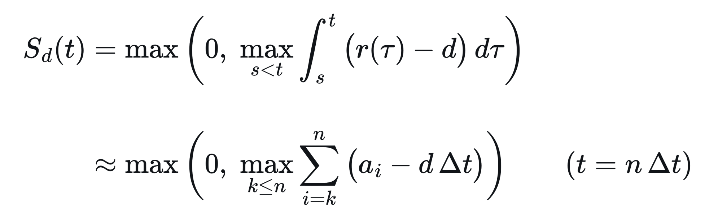
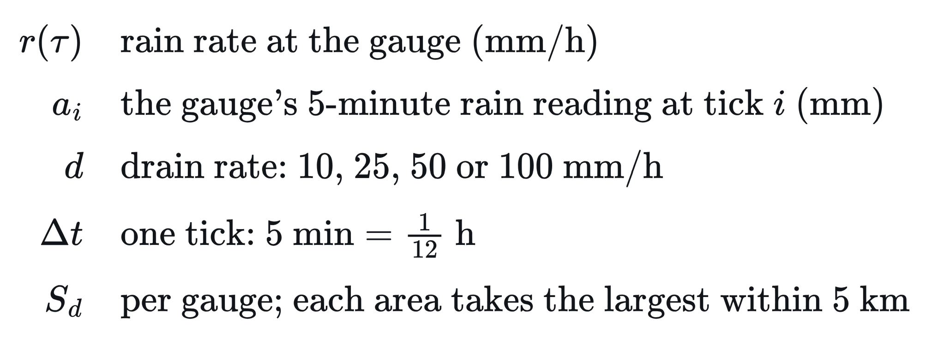
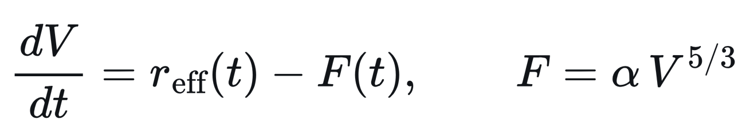
Physics-based Feature

Slide 24
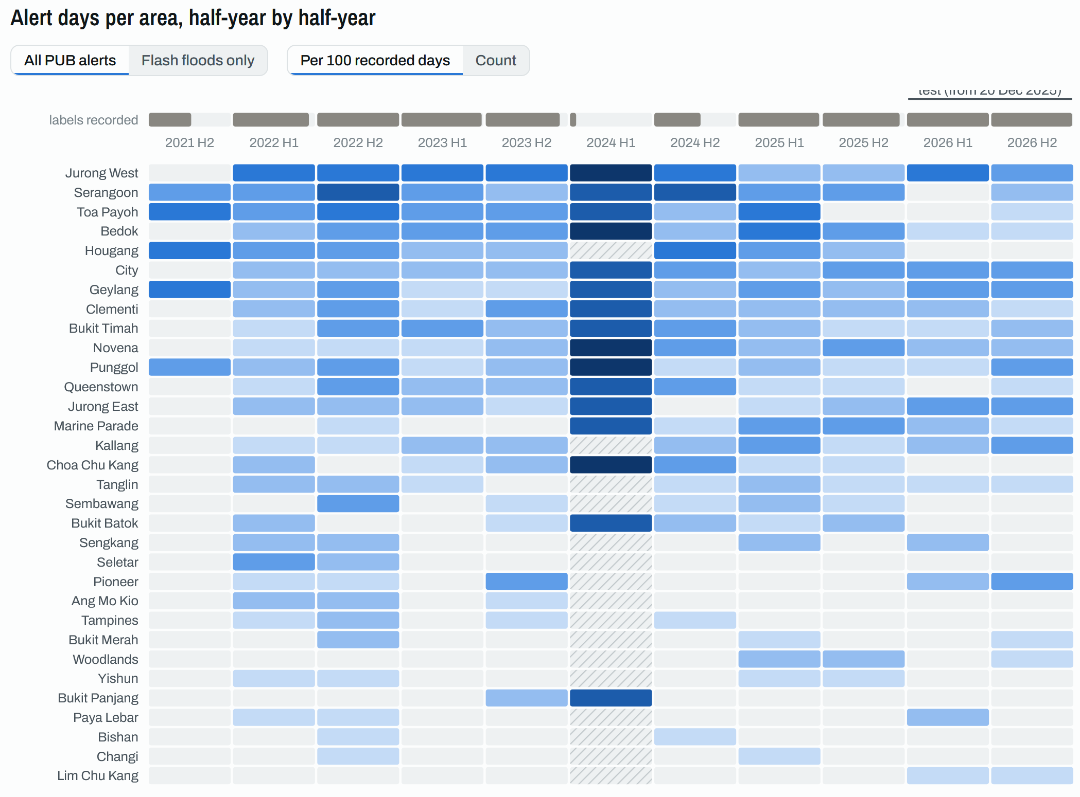
Did PUB fix flood hotspots over time, inflating rates in older data?

Slide 25
One governed platform, from post to phone
Databricks Data Intelligence Platform
ARCHITECTURE
Public data sources
Data ingestion
Lakehouse · Medallion architecture
Intelligence · Serving
Residents and agencies · AI agents
PUB Flood Alerts
Drains 90% full, flash floods; Telegram posts since 2021
Lakeflow Jobs
Python fetchers on serverless: new data every 5 min, a nightly repair, one-off backfills
Bronze
Every API page, post and file as received; full history
Silver
Readings cleaned, posts parsed, alerts placed in NEA's 47 areas
Gold
Each area, every 5 min: rain, forecast, tide, label
MLflow · Unity Catalog
Gated LightGBM pair: each area's chance of a PUB alert within 1 h. 7 checks before @champion moves.
Databricks App
Live map of 47 areas: what to do on foot, driving or at home. Storm replays, warning sign-ups.
Internet Archive
832 deleted PUB posts, recovered from web captures
Residents
Commuters
Live scoring
Every 5 min, @champion rates all 47 areas into a Delta table. New warnings go out by Telegram, email.
Town councils
Agencies
NEA weather
5-min rain, 2-h forecast, wind, humidity (data.gov.sg)
Genie Agent
"FloodSense for agencies": ask in plain English how it did against PUB, flood by flood. Also in the app.
Auto Loader
Each fetch lands as a new file in a UC Volume and streams into bronze once
Tides
NEA tide table; UHSLC hourly sea level at Tanjong Pagar
Lakeflow Spark Declarative Pipelines
Two serverless pipelines. Expectations drop bad readings; unplaceable alerts are quarantined. Hours with lost posts or feed outages count as missing, never as quiet.
Databricks SQL · AI/BI
Serverless warehouse for the app, Genie, agencies' scoreboard
Maps, sensors
328 PUB water-level sensors, URA land use, SLA, OneMap
Unity Catalog

Slide 26
Data Sources
Databricks Data Intelligence Platform
ARCHITECTURE
Public data sources
Data ingestion
Lakehouse · Medallion architecture
Intelligence · Serving
Residents and agencies · AI agents
PUB Flood Alerts
Drains 90% full, flash floods; Telegram posts since 2021
Lakeflow Jobs
Python fetchers on serverless: new data every 5 min, a nightly repair, one-off backfills
Bronze
Every API page, post and file as received; full history
Silver
Readings cleaned, posts parsed, alerts placed in NEA's 47 areas
Gold
Each area, every 5 min: rain, forecast, tide, label
MLflow · Unity Catalog
Gated LightGBM pair: each area's chance of a PUB alert within 1 h. 7 checks before @champion moves.
Databricks App
Live map of 47 areas: what to do on foot, driving or at home. Storm replays, warning sign-ups.
Internet Archive
832 deleted PUB posts, recovered from web captures
Residents
Commuters
Live scoring
Every 5 min, @champion rates all 47 areas into a Delta table. New warnings go out by Telegram, email.
Town councils
Agencies
NEA weather
5-min rain, 2-h forecast, wind, humidity (data.gov.sg)
Genie Agent
"FloodSense for agencies": ask in plain English how it did against PUB, flood by flood. Also in the app.
Auto Loader
Each fetch lands as a new file in a UC Volume and streams into bronze once
Tides
NEA tide table; UHSLC hourly sea level at Tanjong Pagar
Lakeflow Spark Declarative Pipelines
Two serverless pipelines. Expectations drop bad readings; unplaceable alerts are quarantined. Hours with lost posts or feed outages count as missing, never as quiet.
Databricks SQL · AI/BI
Serverless warehouse for the app, Genie, agencies' scoreboard
Maps, sensors
328 PUB water-level sensors, URA land use, SLA, OneMap
Unity Catalog

Slide 27
Lakeflow Jobs || Serverless Compute
Databricks Data Intelligence Platform
ARCHITECTURE
Public data sources
Data ingestion
Lakehouse · Medallion architecture
Intelligence · Serving
Residents and agencies · AI agents
PUB Flood Alerts
Drains 90% full, flash floods; Telegram posts since 2021
Lakeflow Jobs
Python fetchers on serverless: new data every 5 min, a nightly repair, one-off backfills
Bronze
Every API page, post and file as received; full history
Silver
Readings cleaned, posts parsed, alerts placed in NEA's 47 areas
Gold
Each area, every 5 min: rain, forecast, tide, label
MLflow · Unity Catalog
Gated LightGBM pair: each area's chance of a PUB alert within 1 h. 7 checks before @champion moves.
Databricks App
Live map of 47 areas: what to do on foot, driving or at home. Storm replays, warning sign-ups.
Lakeflow Jobs fetch every 5 minutes
Internet Archive
832 deleted PUB posts, recovered from web captures
Fetch · Lakeflow Jobs
Residents
Commuters
flood-live
Serverless, runs every 5 min
9 data.gov.sg live APIs plus PUB Telegram posts
flood-daily
Runs nightly at 00:30
Re-pulls the last two days to fill gaps
flood-backfill
Yearly CSVs since 2021, tides, map layers
API history and 832 deleted PUB posts
Live scoring
Every 5 min, @champion rates all 47 areas into a Delta table. New warnings go out by Telegram, email.
Town councils
Agencies
NEA weather
5-min rain, 2-h forecast, wind, humidity (data.gov.sg)
Genie Agent
"FloodSense for agencies": ask in plain English how it did against PUB, flood by flood. Also in the app.
Auto Loader
Each fetch lands as a new file in a UC Volume and streams into bronze once
Tides
NEA tide table; UHSLC hourly sea level at Tanjong Pagar
Lakeflow Spark Declarative Pipelines
Two serverless pipelines. Expectations drop bad readings; unplaceable alerts are quarantined. Hours with lost posts or feed outages count as missing, never as quiet.
Databricks SQL · AI/BI
Serverless warehouse for the app, Genie, agencies' scoreboard
Maps, sensors
328 PUB water-level sensors, URA land use, SLA, OneMap
Unity Catalog

Slide 28
Auto Loader, Unity Catalog Volume
Databricks Data Intelligence Platform
ARCHITECTURE
Public data sources
Data ingestion
Lakehouse · Medallion architecture
Intelligence · Serving
Residents and agencies · AI agents
PUB Flood Alerts
Drains 90% full, flash floods; Telegram posts since 2021
Lakeflow Jobs
Python fetchers on serverless: new data every 5 min, a nightly repair, one-off backfills
Bronze
Every API page, post and file as received; full history
Silver
Readings cleaned, posts parsed, alerts placed in NEA's 47 areas
Gold
Each area, every 5 min: rain, forecast, tide, label
MLflow · Unity Catalog
Gated LightGBM pair: each area's chance of a PUB alert within 1 h. 7 checks before @champion moves.
Databricks App
Live map of 47 areas: what to do on foot, driving or at home. Storm replays, warning sign-ups.
Auto Loader streams new files into bronze
Internet Archive
832 deleted PUB posts, recovered from web captures
Land · Load · Monitor
Residents
Commuters
Unity Catalog volume
Every fetch lands as a new file
Files are never overwritten
Auto Loader → bronze
Ingests each file exactly once
JSON kept whole, so API changes never break it
Heartbeat & watchdog
Logs status, rows, latency per source
Hourly email alert if feed or predictions go stale
Live scoring
Every 5 min, @champion rates all 47 areas into a Delta table. New warnings go out by Telegram, email.
Town councils
Agencies
NEA weather
5-min rain, 2-h forecast, wind, humidity (data.gov.sg)
Genie Agent
"FloodSense for agencies": ask in plain English how it did against PUB, flood by flood. Also in the app.
Auto Loader
Each fetch lands as a new file in a UC Volume and streams into bronze once
Tides
NEA tide table; UHSLC hourly sea level at Tanjong Pagar
Lakeflow Spark Declarative Pipelines
Two serverless pipelines. Expectations drop bad readings; unplaceable alerts are quarantined. Hours with lost posts or feed outages count as missing, never as quiet.
Databricks SQL · AI/BI
Serverless warehouse for the app, Genie, agencies' scoreboard
Maps, sensors
328 PUB water-level sensors, URA land use, SLA, OneMap
Unity Catalog

Slide 29
Lakehouse, Lakeflow Spark Declarative Pipelines, Medallion Architecture, Expectations, Delta Tables
Databricks Data Intelligence Platform
ARCHITECTURE
Public data sources
Data ingestion
Lakehouse · Medallion architecture
Intelligence · Serving
Residents and agencies · AI agents
flood-etl: bronze → silver
flood-gold: features, labels
PUB Flood Alerts
Drains 90% full, flash floods; Telegram posts since 2021
Lakeflow Jobs
Python fetchers on serverless: new data every 5 min, a nightly repair, one-off backfills
Bronze
Every API page, post and file as received; full history
Silver
Readings cleaned, posts parsed, alerts placed in NEA's 47 areas
Gold
Each area, every 5 min: rain, forecast, tide, label
MLflow · Unity Catalog
Gated LightGBM pair: each area's chance of a PUB alert within 1 h. 7 checks before @champion moves.
Databricks App
Live map of 47 areas: what to do on foot, driving or at home. Storm replays, warning sign-ups.
Refresh · Place · Check
Compute · Model · Guard
Refresh bronze and silver
Dedupes and types readings
Reads PUB's posts
Materialized views
Rain, upwind rain, forecast, tide, terrain, storm memory
Internet Archive
832 deleted PUB posts, recovered from web captures
Residents
Commuters
Live scoring
Every 5 min, @champion rates all 47 areas into a Delta table. New warnings go out by Telegram, email.
Town councils
Agencies
NEA weather
5-min rain, 2-h forecast, wind, humidity (data.gov.sg)
In-pipeline tide model
Checked against NEA's tide table
Place every alert
Into one of NEA's 47 forecast areas
Via PUB sensors, OneMap, manual fixes
Genie Agent
"FloodSense for agencies": ask in plain English how it did against PUB, flood by flood. Also in the app.
Auto Loader
Each fetch lands as a new file in a UC Volume and streams into bronze once
Tides
NEA tide table; UHSLC hourly sea level at Tanjong Pagar
Missing never counts as zero
Readings count only from NEA's publish time
Lakeflow Spark Declarative Pipelines
Two serverless pipelines. Expectations drop bad readings; unplaceable alerts are quarantined. Hours with lost posts or feed outages count as missing, never as quiet.
Expectations
Drop malformed readings
Quarantine bad alerts, review unread posts
Databricks SQL · AI/BI
Serverless warehouse for the app, Genie, agencies' scoreboard
Maps, sensors
328 PUB water-level sensors, URA land use, SLA, OneMap
One feature module, gold and live
534 area-ticks checked, every column matched
Unity Catalog

Slide 30
Unity Catalog, Secrets, One Bundle (DABS), Developer and Production Profiles, Experiments
Databricks Data Intelligence Platform
ARCHITECTURE
Public data sources
Data ingestion
Lakehouse · Medallion architecture
Intelligence · Serving
Residents and agencies · AI agents
Unity Catalog governs every table, file, model and dashboard
PUB Flood Alerts
Drains 90% full, flash floods; Telegram posts since 2021
Lakeflow Jobs
Python fetchers on serverless: new data every 5 min, a nightly repair, one-off backfills
Bronze
Every API page, post and file as received; full history
Silver
Readings cleaned, posts parsed, alerts placed in NEA's 47 areas
Gold
Each area, every 5 min: rain, forecast, tide, label
MLflow · Unity Catalog
Gated LightGBM pair: each area's chance of a PUB alert within 1 h. 7 checks before @champion moves.
Databricks App
Live map of 47 areas: what to do on foot, driving or at home. Storm replays, warning sign-ups.
Unity Catalog · who sees what
One catalog per environment
Bronze, silver, gold, ML and app schemas
Managed volume; dev schemas per teammate
App as its own service principal
Reads analytics, runs the model
Writes only to sign-ups
No group has catalog-wide access
Resident sign-ups isolated
Kept in their own schema
Addresses shown masked
Internet Archive
832 deleted PUB posts, recovered from web captures
Residents
Commuters
Live scoring
Every 5 min, @champion rates all 47 areas into a Delta table. New warnings go out by Telegram, email.
Town councils
Agencies
NEA weather
5-min rain, 2-h forecast, wind, humidity (data.gov.sg)
Genie Agent
"FloodSense for agencies": ask in plain English how it did against PUB, flood by flood. Also in the app.
Secrets · lineage · deployment
Auto Loader
Each fetch lands as a new file in a UC Volume and streams into bronze once
Secrets in a secret scope
API keys, Telegram token, mail credentials
Never in code
Lineage from bronze to gold to app
Every label records who read it
Pattern, person or Jev
One bundle (DABs), dev and prod
7 jobs, 2 pipelines, app, dashboard, Genie space
Experiment, model, 5 schemas, volume
Tides
NEA tide table; UHSLC hourly sea level at Tanjong Pagar
Lakeflow Spark Declarative Pipelines
Two serverless pipelines. Expectations drop bad readings; unplaceable alerts are quarantined. Hours with lost posts or feed outages count as missing, never as quiet.
Databricks SQL · AI/BI
Serverless warehouse for the app, Genie, agencies' scoreboard
Maps, sensors
328 PUB water-level sensors, URA land use, SLA, OneMap
Unity Catalog

Slide 31
MLflow, @Challenger, @Champion, 14 Versions
Databricks Data Intelligence Platform
ARCHITECTURE
Public data sources
Data ingestion
Lakehouse · Medallion architecture
Intelligence · Serving
Residents and agencies · AI agents
MLflow tracks every model; an alias picks the live one
PUB Flood Alerts
Drains 90% full, flash floods; Telegram posts since 2021
Lakeflow Jobs
Python fetchers on serverless: new data every 5 min, a nightly repair, one-off backfills
Bronze
Every API page, post and file as received; full history
Silver
Readings cleaned, posts parsed, alerts placed in NEA's 47 areas
Gold
Each area, every 5 min: rain, forecast, tide, label
MLflow · Unity Catalog
Gated LightGBM pair: each area's chance of a PUB alert within 1 h. 7 checks before @champion moves.
Databricks App
Live map of 47 areas: what to do on foot, driving or at home. Storm replays, warning sign-ups.
Train · Log · Register · Verify
Train
One run per training, each design nested
Scored out of fold on 5 day-blocks
Log
Metrics with 95% intervals
Feature importance, flood-by-flood table
Register
Best fit logged as pyfunc with code
Saved as @challenger, 14 versions
Verify
7 checks before @champion moves
E.g. more rain never lowers risk
Internet Archive
832 deleted PUB posts, recovered from web captures
Residents
Commuters
Live scoring
Every 5 min, @champion rates all 47 areas into a Delta table. New warnings go out by Telegram, email.
Town councils
Agencies
NEA weather
5-min rain, 2-h forecast, wind, humidity (data.gov.sg)
Genie Agent
"FloodSense for agencies": ask in plain English how it did against PUB, flood by flood. Also in the app.
Auto Loader
Each fetch lands as a new file in a UC Volume and streams into bronze once
Serve: switching models means moving an alias
Tides
NEA tide table; UHSLC hourly sea level at Tanjong Pagar
Load @champion
Live scoring, replays and scoreboard
All load the same alias
Lakeflow Spark Declarative Pipelines
Two serverless pipelines. Expectations drop bad readings; unplaceable alerts are quarantined. Hours with lost posts or feed outages count as missing, never as quiet.
Traceable
Every prediction records its model version
Databricks SQL · AI/BI
Serverless warehouse for the app, Genie, agencies' scoreboard
Maps, sensors
328 PUB water-level sensors, URA land use, SLA, OneMap
Unity Catalog

Slide 32
ML Schema, AI/BI dashboard, SQL Warehouse
Databricks Data Intelligence Platform
ARCHITECTURE
Public data sources
Data ingestion
Lakehouse · Medallion architecture
Intelligence · Serving
Residents and agencies · AI agents
A scoreboard compares FloodSense with PUB
PUB Flood Alerts
Drains 90% full, flash floods; Telegram posts since 2021
Lakeflow Jobs
Python fetchers on serverless: new data every 5 min, a nightly repair, one-off backfills
Bronze
Every API page, post and file as received; full history
Silver
Readings cleaned, posts parsed, alerts placed in NEA's 47 areas
Gold
Each area, every 5 min: rain, forecast, tide, label
MLflow · Unity Catalog
Gated LightGBM pair: each area's chance of a PUB alert within 1 h. 7 checks before @champion moves.
Databricks App
Live map of 47 areas: what to do on foot, driving or at home. Storm replays, warning sign-ups.
Score · Publish · Visualize
flood-scoreboard
Scores ~4M area-ticks since training ended
Model vs. simple rainfall rule
4 tables + 3 views
Published to the ML schema
AI/BI dashboard
4 pages on serverless SQL
Scoreboard, flash floods, warnings by area, PUB alerts since 2022
Internet Archive
832 deleted PUB posts, recovered from web captures
Residents
Commuters
Live scoring
Every 5 min, @champion rates all 47 areas into a Delta table. New warnings go out by Telegram, email.
Town councils
Agencies
NEA weather
5-min rain, 2-h forecast, wind, humidity (data.gov.sg)
Genie Agent
"FloodSense for agencies": ask in plain English how it did against PUB, flood by flood. Also in the app.
Auto Loader
Each fetch lands as a new file in a UC Volume and streams into bronze once
Why the numbers can be trusted
Tides
NEA tide table; UHSLC hourly sea level at Tanjong Pagar
95% intervals, honest gaps
Main shares carry 95% intervals
Lost-post hours excluded, not scored as quiet
Lakeflow Spark Declarative Pipelines
Two serverless pipelines. Expectations drop bad readings; unplaceable alerts are quarantined. Hours with lost posts or feed outages count as missing, never as quiet.
Embedded credentials
Viewers need no table access
Shown in the app's For agencies view
Databricks SQL · AI/BI
Serverless warehouse for the app, Genie, agencies' scoreboard
Maps, sensors
328 PUB water-level sensors, URA land use, SLA, OneMap
Unity Catalog

Slide 33
Databricks Apps, AI/BI Dashboard
Databricks Data Intelligence Platform
ARCHITECTURE
Public data sources
Data ingestion
Lakehouse · Medallion architecture
Intelligence · Serving
Residents and agencies · AI agents
FloodSense app: React on FastAPI, its own service principal
PUB Flood Alerts
Drains 90% full, flash floods; Telegram posts since 2021
Lakeflow Jobs
Python fetchers on serverless: new data every 5 min, a nightly repair, one-off backfills
Bronze
Every API page, post and file as received; full history
Silver
Readings cleaned, posts parsed, alerts placed in NEA's 47 areas
Gold
Each area, every 5 min: rain, forecast, tide, label
MLflow · Unity Catalog
Gated LightGBM pair: each area's chance of a PUB alert within 1 h. 7 checks before @champion moves.
Databricks App
Live map of 47 areas: what to do on foot, driving or at home. Storm replays, warning sign-ups.
Four views
Now
Map of 47 areas: warning, reason, advice
Address search and sign-up
Replay
Replays unseen storm days
13,536 area-ticks in under a minute, then cached
Track record
Read straight from the live model's MLflow run
For agencies
Embedded AI/BI scoreboard and Genie
Internet Archive
832 deleted PUB posts, recovered from web captures
Residents
Commuters
Live scoring
Every 5 min, @champion rates all 47 areas into a Delta table. New warnings go out by Telegram, email.
Town councils
Agencies
NEA weather
5-min rain, 2-h forecast, wind, humidity (data.gov.sg)
Genie Agent
"FloodSense for agencies": ask in plain English how it did against PUB, flood by flood. Also in the app.
Auto Loader
Each fetch lands as a new file in a UC Volume and streams into bronze once
Data and delivery · deployed from the bundle
Tides
NEA tide table; UHSLC hourly sea level at Tanjong Pagar
Data
Via serverless SQL warehouse
Lakeflow Spark Declarative Pipelines
Two serverless pipelines. Expectations drop bad readings; unplaceable alerts are quarantined. Hours with lost posts or feed outages count as missing, never as quiet.
Alerts
New warnings pushed to Telegram @daisi_floodsense and email
Databricks SQL · AI/BI
Serverless warehouse for the app, Genie, agencies' scoreboard
Maps, sensors
328 PUB water-level sensors, URA land use, SLA, OneMap
Unity Catalog

Slide 34
Genie Agent
Databricks Data Intelligence Platform
ARCHITECTURE
Public data sources
Data ingestion
Lakehouse · Medallion architecture
Intelligence · Serving
Residents and agencies · AI agents
PUB Flood Alerts
Drains 90% full, flash floods; Telegram posts since 2021
Lakeflow Jobs
Python fetchers on serverless: new data every 5 min, a nightly repair, one-off backfills
Bronze
Every API page, post and file as received; full history
Silver
Readings cleaned, posts parsed, alerts placed in NEA's 47 areas
Gold
Each area, every 5 min: rain, forecast, tide, label
MLflow · Unity Catalog
Gated LightGBM pair: each area's chance of a PUB alert within 1 h. 7 checks before @champion moves.
Databricks App
Live map of 47 areas: what to do on foot, driving or at home. Storm replays, warning sign-ups.
Internet Archive
832 deleted PUB posts, recovered from web captures
Residents
Commuters
Live scoring
Every 5 min, @champion rates all 47 areas into a Delta table. New warnings go out by Telegram, email.
Town councils
Agencies
NEA weather
5-min rain, 2-h forecast, wind, humidity (data.gov.sg)
Genie answers stakeholders in plain English
Genie Agent
"FloodSense for agencies": ask in plain English how it did against PUB, flood by flood. Also in the app.
Auto Loader
Each fetch lands as a new file in a UC Volume and streams into bronze once
Genie Agent · "FloodSense for agencies"
Tides
NEA tide table; UHSLC hourly sea level at Tanjong Pagar
7 tables, 1 bundle
Reads the scoreboard's 7 tables, views
Defined in the bundle
Shared language
Defines "false alarm", "2026", "right now"
Synonyms, entity matching
7 SQL examples
In every view
Asked from every app view via the Conversation API
Answers cached 6 hours
Lakeflow Spark Declarative Pipelines
Two serverless pipelines. Expectations drop bad readings; unplaceable alerts are quarantined. Hours with lost posts or feed outages count as missing, never as quiet.
Databricks SQL · AI/BI
Serverless warehouse for the app, Genie, agencies' scoreboard
Maps, sensors
328 PUB water-level sensors, URA land use, SLA, OneMap
Unity Catalog

Slide 35
The Champion
Every 5 min, it rates each of NEA's 47 areas for a PUB flood alert within the hour
How a rating is made
Inputs
Rain at the area, nearby and upwind; NEA's 2-hour forecast; weather and tide
Storm memory
How long the storm has lasted, rain the drains haven't cleared, plus a physics-based simple drain simulation.
Two-step model
LightGBM #1 skips quiet periods, #2 rates the rest; thin area records lean on the island-wide rate
Risk rating
Low <3%, Moderate ≥3%, Elevated ≥5%; Stays a warning for 1 hour
Trained and checked before going live
Oct 2021 – Dec 2025
Trained only where PUB alert and rain data are complete
MLflow + Unity Catalog
Tracked, registered, passed 7 automated checks to go live

Slide 36
ai-dev-kit: leaner builds
Cut Claude usage
by about half

